Slide 1

L1.1 Introduction and Overview
Zonghua Gu, Umeå University
Nov. 2023

Slide 2
Course Logistics
Lectures Mon & Wed 15:30-17:00 via Zoom.
Link: https://umu.zoom.us/j/62818040552
Instructor: Zonghua Gu, zonghua.gu@umu.se
Course info (Welcome Letter, Syllabus, etc.):
https://www.umu.se/en/education/courses/algorithms-and-systems-for-autonomous-vehicles/
Notes:
Required Knowledge/Prerequisites:
If you have not taken courses in the field of Artificial Intelligence or Machine Learning of at least 7.5 Credits, but you feel that you have the prerequisite knowledge in AI/ML through other courses or self-study, please contact the instructor zonghua.gu@umu.se to register for the course.

Slide 3
My Instruction Style
No textbook. Will discuss classic techniques as well as latest research advances
I provide detailed, self-contained PowerPoint slides
All exam questions come from these slides. Some slides may be verbose for the sake of completeness
In-class questions and discussions are welcome
You can either speak up during lecture, or type in the chat window. For questions after class, please use the Canvas discussion board so everyone can see the discussions
Lecture videos are recorded and put in UmU Play after each class, so in-class attendance is not mandatory

Slide 4
Course Materials
I will put lecture materials here instead of on Canvas. Please bookmark this link:
https://guzonghua.github.io/saav/
Canvas used for discussions, submission of labs and final exam
Since slides may be updated slightly after each class, it is more convenient to put them on GitHub
Previous course contents available:
https://guzonghua.github.io/saav2022/
https://guzonghua.github.io/saav2021/ (with YouTube videos)
Contents updated every year

Slide 5
Lecture Schedule
Lec Date | Lecture Notes | Topics Discussed
W1 | L1.1 Introduction and Overview PPTX, PDF L1.2 AV Sensors HD Map PPTX, PDF | Background, history, AD processing pipeline
W2 | L1.3 HWSW Platforms V2X PPTX, PDF | Sensors and perception, HD maps, HW platforms, SW platforms, V2X communication
W2 | L2 Intro to Machine Learning PPTX, PDF | Activation functions, Cross-Entropy Loss, SoftMax, ROC and AUC, NN training issues
W3 | L3.1 CNN for Computer Vision PPTX, PDF | Intro to CNN, case studies (LeNet, AlexNet, VGGNet, GooLeNet, ResNet...)
W4 | L3.2 Adversarial Attacks PPTX, PDF | Adversarial attacks
W5 | L4 Object Detection and Segmentation PPTX, PDF | Object detection (R-CNN, Fast R-CNN, Faster R-CNN, Single-Stage Detectors), object segmentation
W6 | L5 Planning PPTX, PDF | Route planning, behavior planning, local planning, Responsibility Sensitive Safety (RSS)
W7 | L6 Control Theory PPTX, PDF | PID, MPC, Udacity racetrack control, PID tuning with twiddle()
W8 | L7.1 MDP Planning, PPTX, PDF | Markov Decision Process (MDP), Bellman Equations, Policy Iteration, Value Iteration
W8 | L7.2 Q-Learning, PPTX, PDF | Q-learning
W9 | L8 Latest Research Advances | TBD
W10 | Final Exam, Jan. 12, 2024, 15:00-17:30, Online on Zoom, Sample Exam Questions

Slide 6
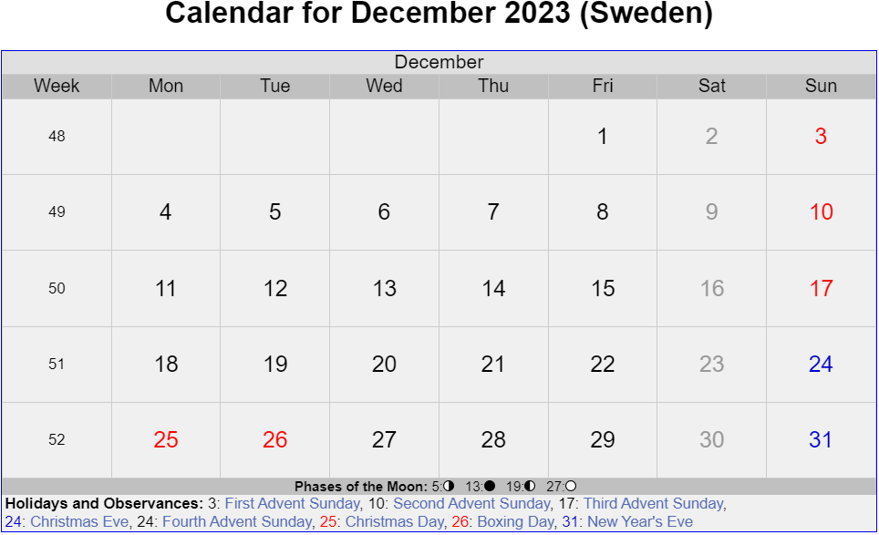
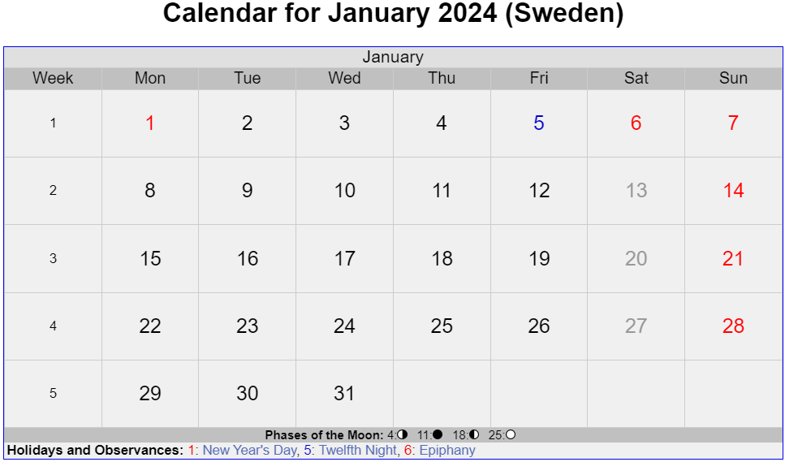
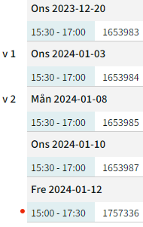
Public Holidays
Holidays
Final Exam
Holidays

Slide 7
Lab Sections
Lab materials: https://github.com/guzonghua/saavlabs
Students should form teams of 1-3 people each for the lab sections.
Please sign up for groups in Canvas before 11-22.
To help you form groups to work on the lab assignments, please join the discord channel:
https://discord.gg/6VG5xWBQ
The programming workload is relatively low, e.g., you may be given a semi-complete program, and asked to fill in a few lines of missing code (no large-scale coding).
The computing demand is relatively low, so you can use Google Colab, or work on your own computer without a powerful GPU (Programming language is Python).
Assign Date | Assignment | Due Date
11-22 | Lab1. Adversarial Attacks on a CNN for Traffic Sign Classification | 12-06
12-06 | Lab2. PID Control | 12-20
12-20 | Lab3. DQN RL for Highway Driving, Video Lecture | 01-12
11-24 | LabX. Bonus project | 01-12
Notes:
Shall we create a Discord channel or Slack? To keep in touch?
From Stellan Lange to Everyone 04:30 PM
Would be fun to also have a Discord thread to discuss future LabX ideas, current work some o
Each team member should submit the same copy of report/source code in Canvas.

Slide 8
LabX. Optional Bonus Project
Each group may choose to work on an optional bonus project, to give you a chance to explore your own interests based on what you have learned in the course.
Please submit a proposal (on Canvas) before the end of W4 (11-24), if you plan to work on a bonus project.
The proposal should be at most 2 pages long, and describe the background, proposed work and why it is relevant to the course.
Submit the project report before the end of term (01-12)
The report should be at most 6 pages long.
Notes:
If you do not submit a proposal on time, then you will not be working on the bonus project.

Slide 9
Final Exam
Friday, Jan. 12, 2024, 15:00 – 17:30, online on ZOOM
Covers lecture PPTs. Held as a quiz on Canvas
Multiple choice questions
Simple calculation questions
Sample Exam Questions
Open book, honor system
You may search online, but should not talk with your friends

Slide 10
Grading Rules
Maximum 100 points:
Final exam: 60 points
Lab sections: 40 points (15+15+10)
LabX: 10 points (if total number of points exceeds 100, then it is set to 100)
One of the grades Fail (U), Pass (3), Pass with Credit (4) or Pass with Distinction (5) is given
To obtain grade (3), at least 50 points are required
For grade (4), at least 65 points
For grade (5), at least 80 points
For students who have not obtained the grade Pass (3+), other examination sessions will be arranged

Slide 11
Pass or Fail?
In the past, vast majority of students who finished the course have passed the course
Those who submitted all labs on time, and took the exam
Course workload is not very high. Most students find it managable
Use the anonymous feedback link (bottom of course page) to provide comments on course pace, level of difficulty, etc.

Slide 12
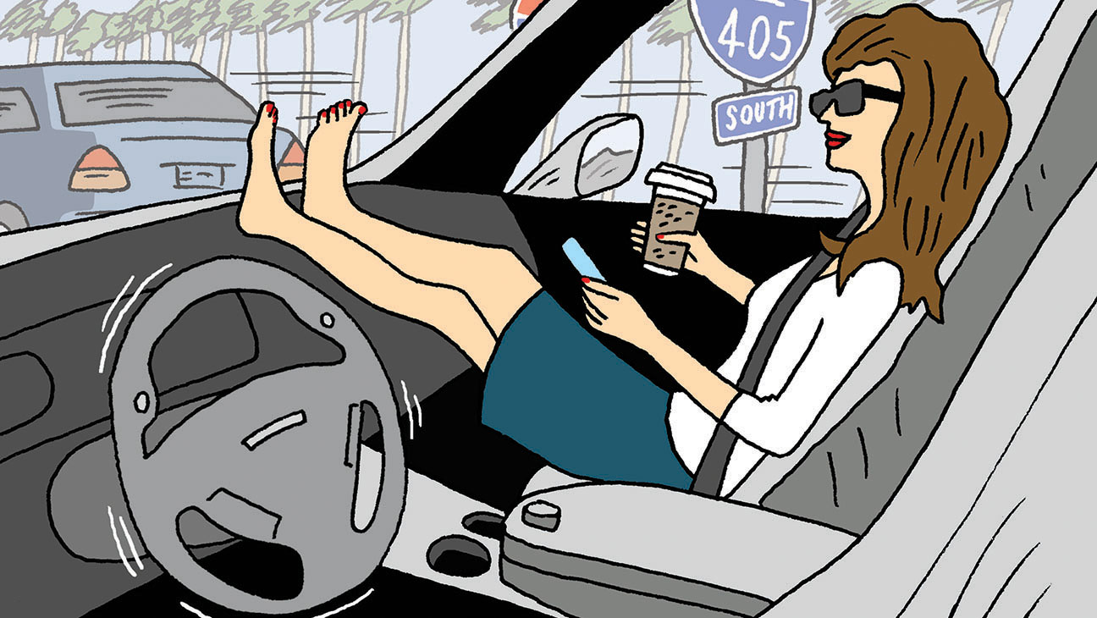
Overview of AV Technology
https://www.hollywoodreporter.com/news/general-news/driving-cars-could-add-billions-905966/

Slide 13
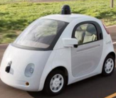
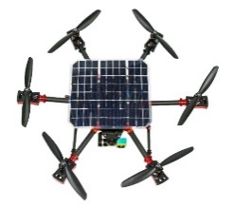
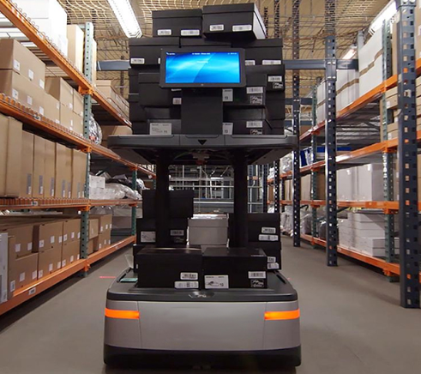
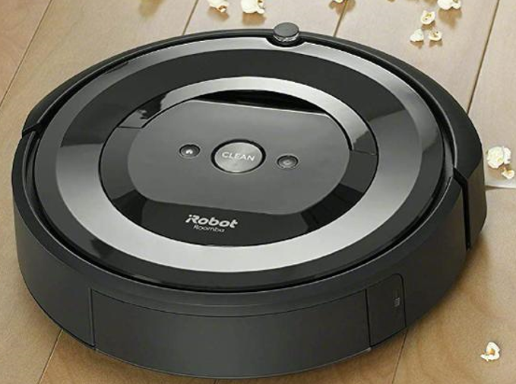
Autonomous Vehicles (AVs)
Can refer to any type of Autonomous Mobile Robot.
Not just Self-Driving Cars (SDCs)
Techniques covered in this course are generally applicable to all types of AVs.
Self-Driving Cars
Drones
Warehouse Robots
Indoor-Cleaning Robots

Slide 14
Why Autonomous Driving?
Reduced traffic accidents and fatalities
In 2019, an estimated 38,800 people lost their lives to car crashes in the US. About 4.4 million people were injured seriously enough to require medical attention in crashes.
Reduced congestion and pollution
More productive time spent on the road
Autonomous Mobility-on-Demand (AMoD) with a fleet of robotaxis
Low-cost, safe and efficient mode of transportation that may make vehicle ownership obsolete.
The dream of Uber (and many other companies)

Slide 15
Advanced Driver Assistance (ADAS)
Since the initial introduction of Cruise Control in 1948, ADAS functions are increasingly prevalent in modern vehicles.
Adaptive cruise control (ACC), Anti-lock braking system, Collision avoidance system (Pre-crash system), Driver Monitoring System (DMS), Electronic Stability Control (ESC), Forward Collision Warning (FCW), Lane Departure Warning (LDW), Lane Change Assistance, Surround View…

Slide 16
DARPA Grand Challenges
2004 challenge
Held in the Mojave Desert region of the USA, along a 150-mile route.
None of the robot vehicles finished the route. No winner was declared, and the cash prize was not given.
2005 challenge
Vehicles passed through three narrow tunnels and negotiated more than 100 sharp left and right turns.
Five vehicles successfully completed the 132 mi course. Stanford’s Stanley won the $2M top prize.
2007 challenge
The course involved a 60 mi urban area course to be completed in less than 6 hours. Rules included obeying all traffic regulations while negotiating with other traffic and obstacles and merging into traffic.
The 3 Grand Challenge races jump-started the Self-Driving Car industry. Faculty and students from winning teams such as Stanford and CMU later became leaders in SDC projects at companies like Google/Waymo and Uber and numerous startups.

Slide 17
Brief History of AVs
Google’s AV passes a 14-mile driving test in Nevada
Uber hires 40 CMU robotics researchers to work on AVs; Ford begins testing its AVs.
NHTSA issues revised safety guidelines for AVs
DARPA Grand Challenges
Google begins AV project
Tesla releases Auto-Pilot
2004/05
2009
2012
2015
2015
2017
2007
2013
2013
2016
2016
DARPA Urbane Challenge
Mercedes and Infiniti produce cars with radar sensors and some AD features
NHTSA
releases initial policy on AVs
Major acquisitions and partnerships (GM and Cruise Automation; GM and Lyft; Toyota and Jaybridge Robotics; Uber and Volvo)
NHTSA issues guidelines for testing and deployment of AVs
https://www.mcca.com/wp-content/uploads/2018/04/Autonomous-Vehicles.pdf

Slide 18
Highway vs. City Driving
Highway driving is perceived as an easier problem than city driving.
Has potential of massive displacement of truck driver jobs
But traffic merging is tricky and may require human operator assistance
 | Highway Driving | City Driving
Travel Speed | High | Low to medium
Traffic Volume | High | Medium to high
Number of Lanes | Large (6-8) | Small (2-4)
Others | Entry and exit points for traffic merging | Many intersections with traffic lights

Slide 19
Operational Design Domain (ODD)
The ODD defines the conditions under which a vehicle is designed to function and is expected to perform safely. The ODD includes (but isn’t limited to) environmental, geographical, and time-of-day restrictions, as well as traffic or roadway characteristics.
e.g., an autonomous freight truck might be designed to transport cargo from a seaport to a distribution center 30 Km away, via a specific route, in day-time only. This vehicles ODD is limited to the prescribed route and time-of-day, and it should not operate outside of it

Slide 20
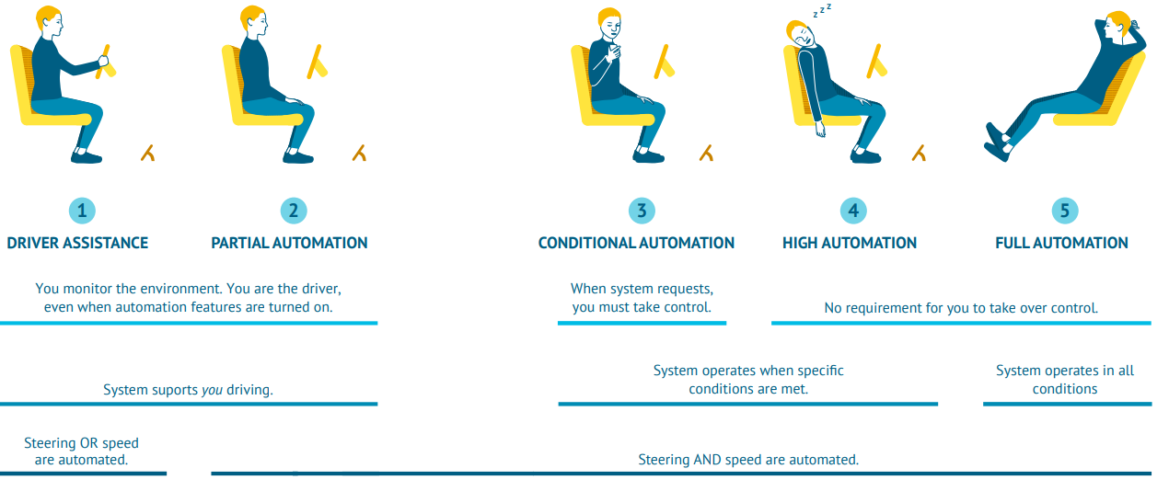
Five Levels of Automation
L1: ADAS features that either control steering or speed to support the driver.
L2: both steering and acceleration are simultaneously handled by AD system. The human driver still monitors the environment and supervises the support functions.
L3: Conditional automation: the system can drive without the need for a human to monitor and respond. However, the system might ask a human to intervene, so the driver must be able to take control at all times.
L4: These systems have high automation and can fully drive themselves under certain conditions. The vehicle won’t drive if not all conditions are met.
L5: Full automation, the vehicle can drive wherever, whenever, with unlimited ODD.
https://www.wevolver.com/article/2020.autonomous.vehicle.technology.report

Slide 21
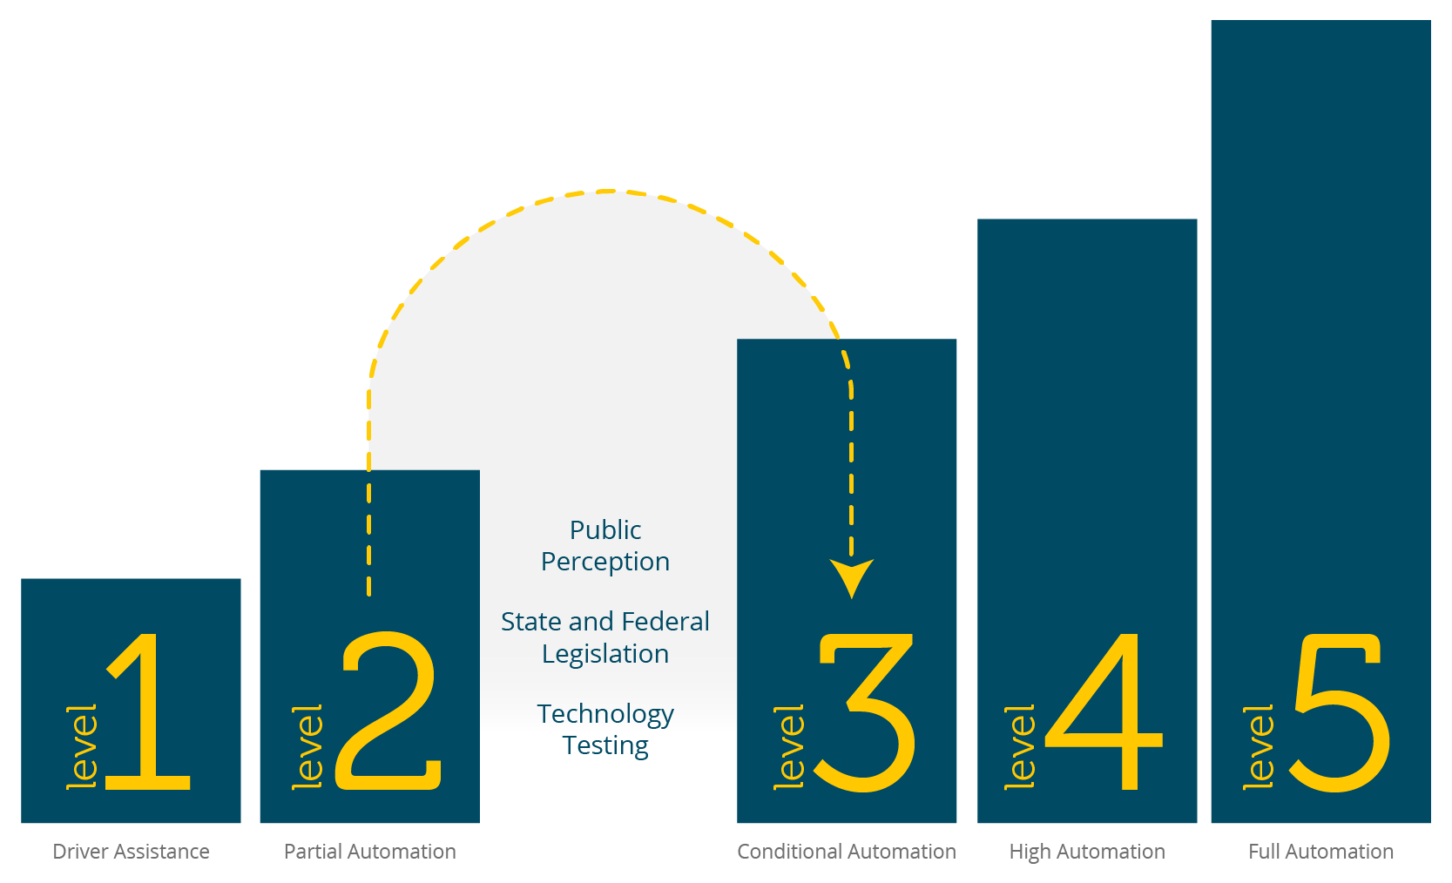
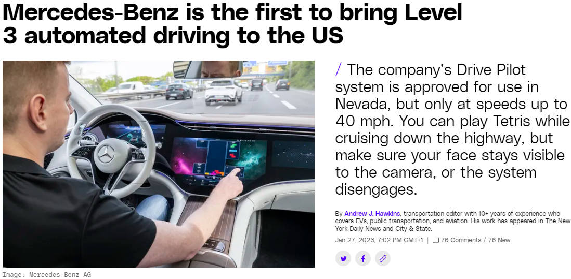
State-of-the-Art
Current commercial products are at most L2 (e.g., Tesla Autopilot)
L2 to L3 is perceived to be a giant leap
Automakers keep pushing the timeline of L3 and above to the future…
Notes:
https://www.forbes.com/sites/jamesmorris/2021/03/13/why-is-teslas-full-self-driving-only-level-2-autonomous/?sh=f7ed99c6a320
https://thenextweb.com/shift/2020/02/27/6-levels-autonomous-self-driving-explained-tesla-waymo-autopilot/
https://europe.autonews.com/automakers/lexus-prepares-introduce-level-2-autonomy

Slide 22
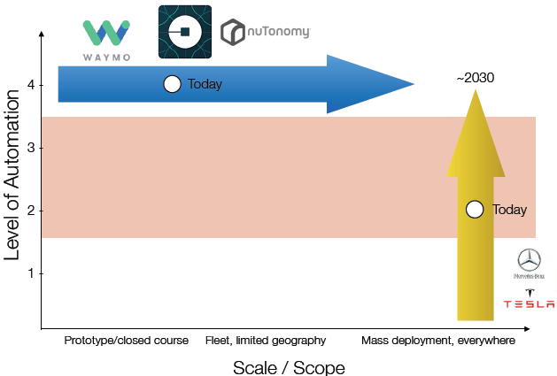
Two Different Paths to L4/5
Tesla starts from L2 and mass deployment, and gradually moves to L4/5.
Waymo, nuTonomy…starts from L4 in limited ODD, and gradually expands deployment
Emilio Frazzoli, nuTonomy

Slide 23
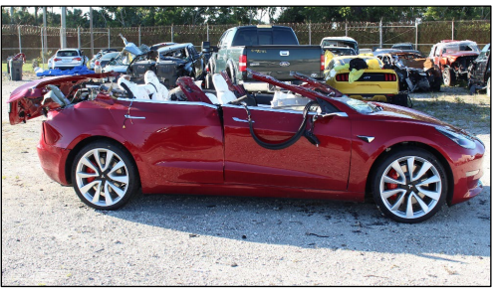
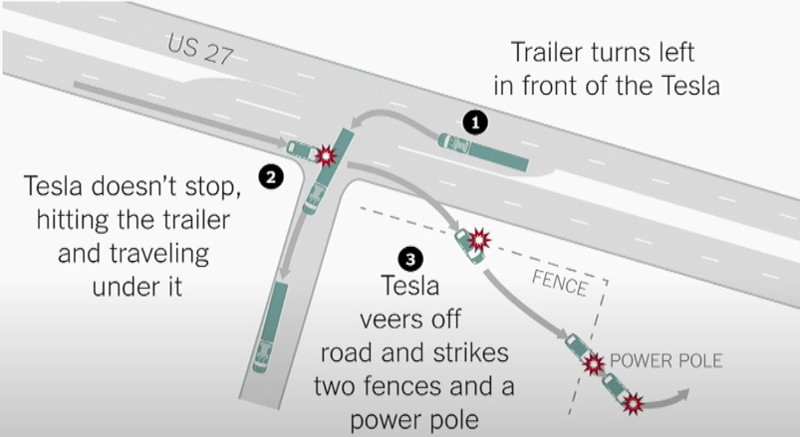
The Tesla Fatality (May 2016)
A Tesla Model S was driving 74 mph on the highway when it was struck by a truck
Tesla: “Neither Autopilot nor the driver noticed the white side of the truck against a brightly lit sky, so the brake was not applied.”
A failure of computer vision algorithm for object detection
Notes:
The driver’s hands were off the steering wheel for a total of 37 minutes during the 37.5 minutes of time the car was in Autopilot, despite repeated visual warnings

Slide 24
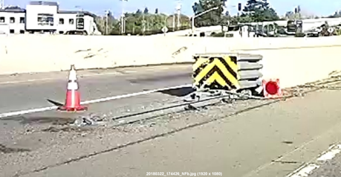
The Tesla Fatality (Mar 2018)
In 2018, a man died from a high-speed crash because his Tesla Autopilot system steered the car into a median on Highway 101 in CA.
Limitations on Tesla's Autopilot Lane-Keeping Assistance (LKA) caused the vehicle to veer into the median and failed to provide an alert to the driver in the seconds leading to the crash.
The collision avoidance system was not designed to detect a crash attenuator, which resulted in a severe crash in which the automatic braking and collision warning systems failed to activate.
A failure of computer vision algorithm for lane tracking.
Tesla Autopilot 2 almost crashes Into Barrier (similar to this crash)
https://www.youtube.com/watch?v=TIUU1xNqI8w
https://www.mv-voice.com/news/2020/02/25/ntsb-teslas-autopilot-steered-model-x-into-highway-median-causing-fatal-mountain-view-crash

Slide 25
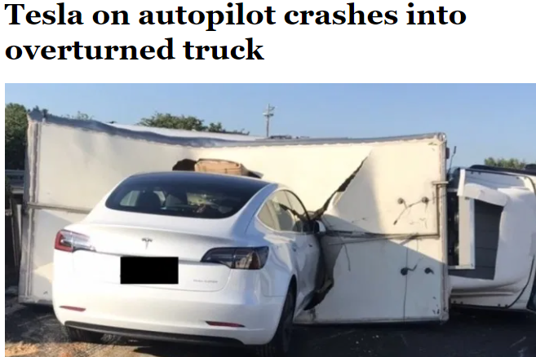
Tesla vs. Truck (Jun 2020)
Tesla crashes into overturned truck on a busy highway in Taiwan
Video: https://taiwanenglishnews.com/tesla-on-autopilot-crashes-into-overturned-truck/

Slide 26
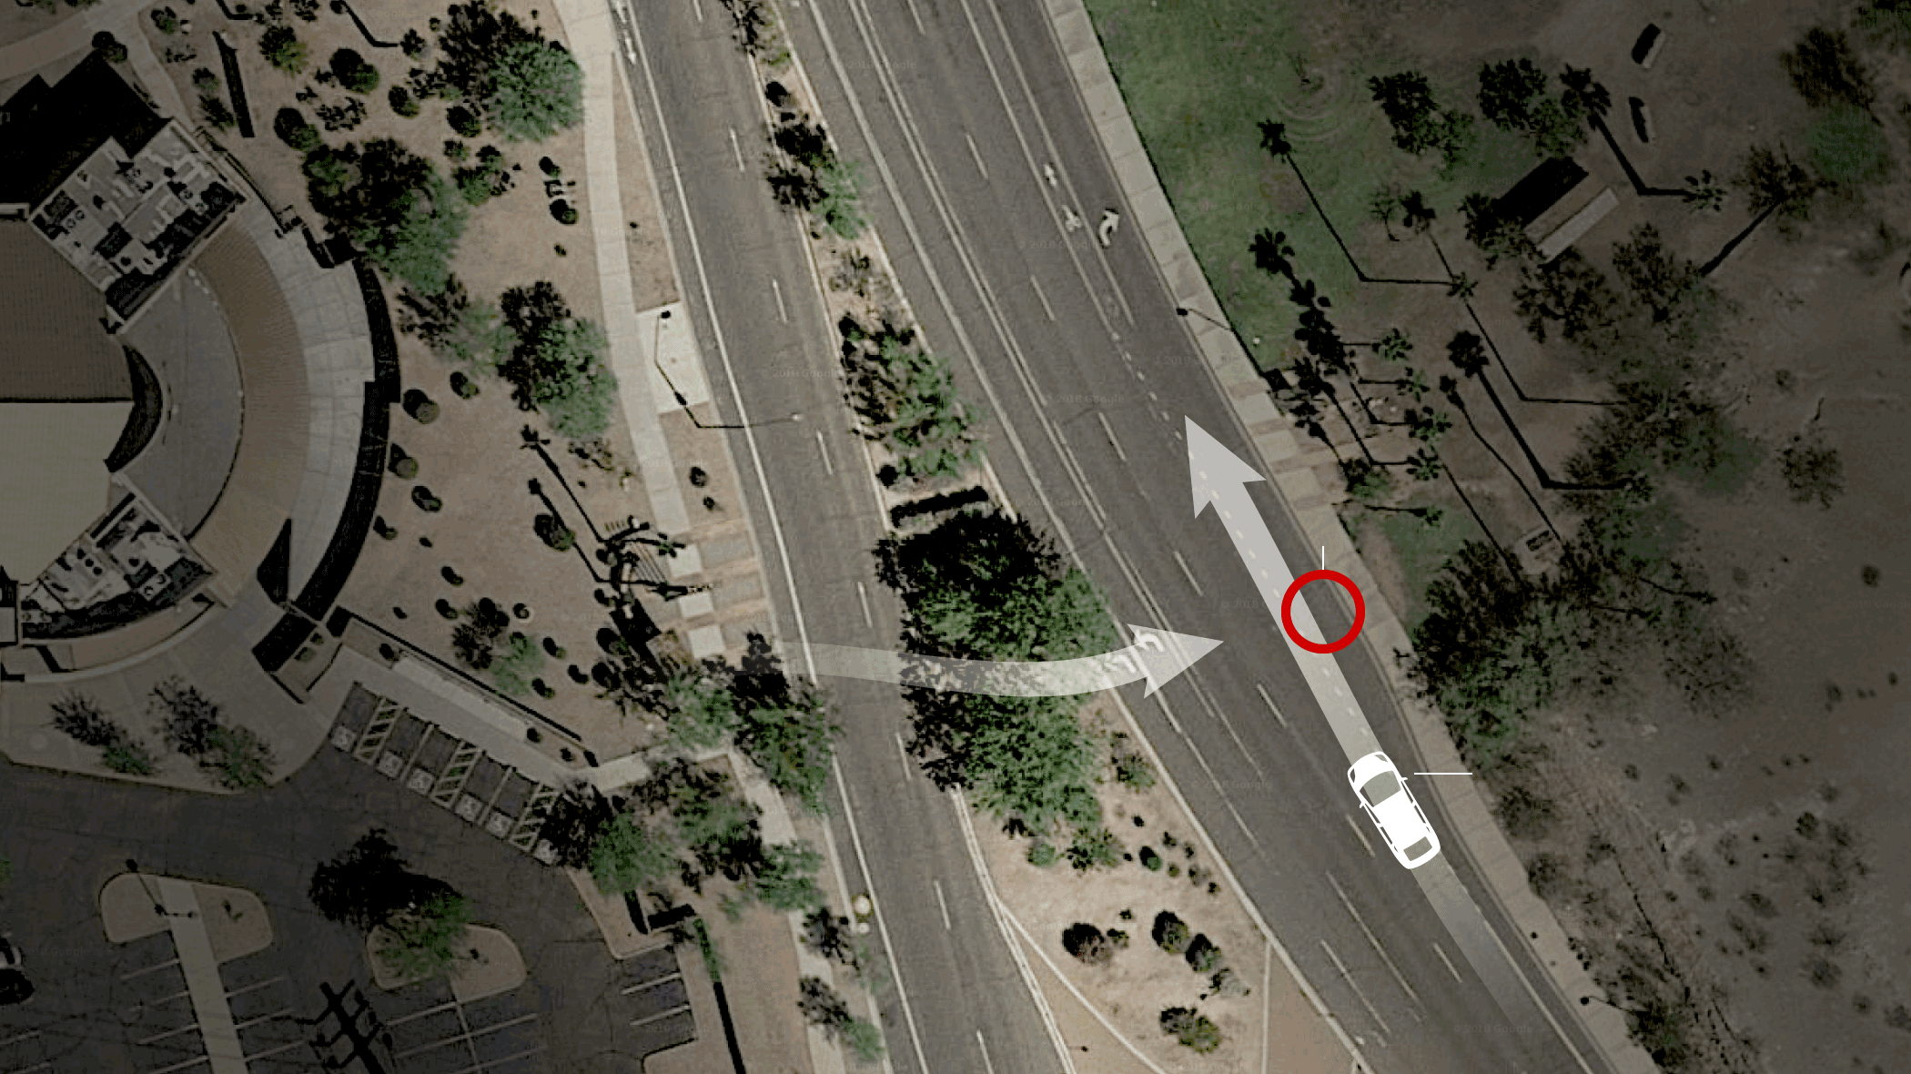
The Uber Pedestrian Fatality (Mar 2018)
Video of Uber collision that killed pedestrian
https://www.youtube.com/watch?v=q7d90ZFhg28
After the woman was detected on the road (6 sec before crash), she was:
first classified as unknown object
then misclassified as a vehicle
then as a bicycle
1.3 sec before, the Volvo system tried to do emergency braking maneuver
but Uber had disabled it for testing
The safety driver was not watching the road moments before crash
It was probably too dark for the driver to see her in time
The AV was equipped with both Lidar and Radar
“This is exactly the type of situation that Lidar and radar are supposed to pick up. This is a catastrophic failure that happened with Uber’s technology.” – Prof. David King.

Slide 27
Tesla Wins in Court (Oct 2023)
Tesla won the first U.S. trial over allegations that its Autopilot driver assistant feature led to a death
In 2019, a Tesla Model 3 suddenly veered off a highway at 65 MPH, struck a palm tree and burst into flames, killing the driver and seriously injuring two passengers
Tesla argued that the crash was the result of human error — the same stance it’s taken in other Autopilot lawsuits
https://www.reuters.com/business/autos-transportation/tesla-wins-autopilot-trial-involving-fatal-crash-2023-10-31/

Slide 28
AD Safety Evaluation by California DMV
A disengagement report is required from the 43 companies currently licensed to test autonomous cars on public roads in California.
California is currently the only region in the world where we have such data publicly available.
A disengagement can be described as the event when the AV either got stuck and handed over control to a safety driver present in the vehicle, or when a safety driver took control himself.
Number of vehicles deployed per manufacturer in the 2022 reporting period
https://thelastdriverlicenseholder.com/2023/02/17/2022-disengagement-report-from-california/
Notes:
https://thelastdriverlicenseholder.com/2023/02/17/2022-disengagement-report-from-california/

Slide 29
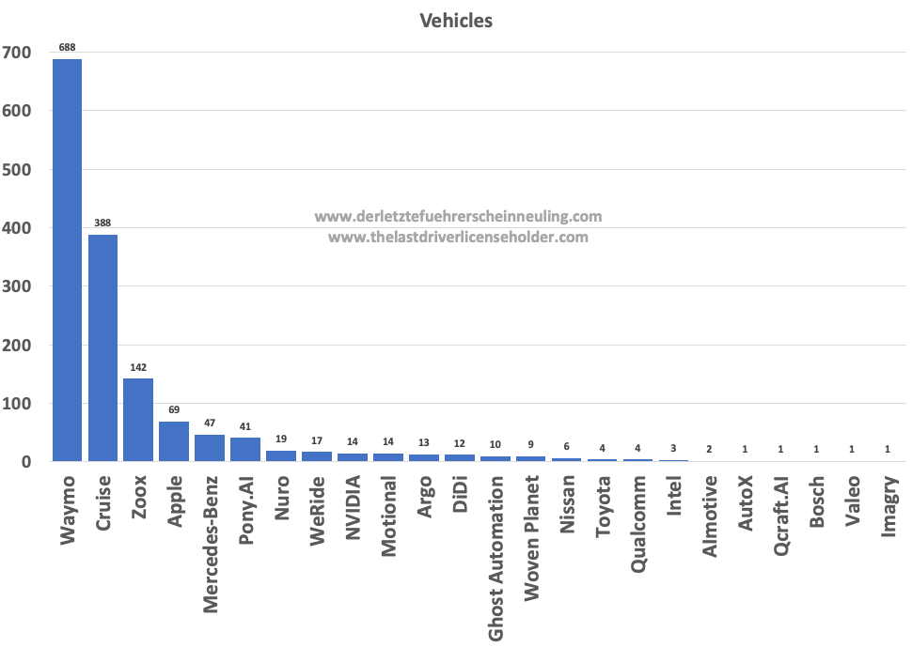
Reports with Safety Drivers (2022)
Number of vehicles deployed per manufacturer in the 2022 reporting period

Slide 30
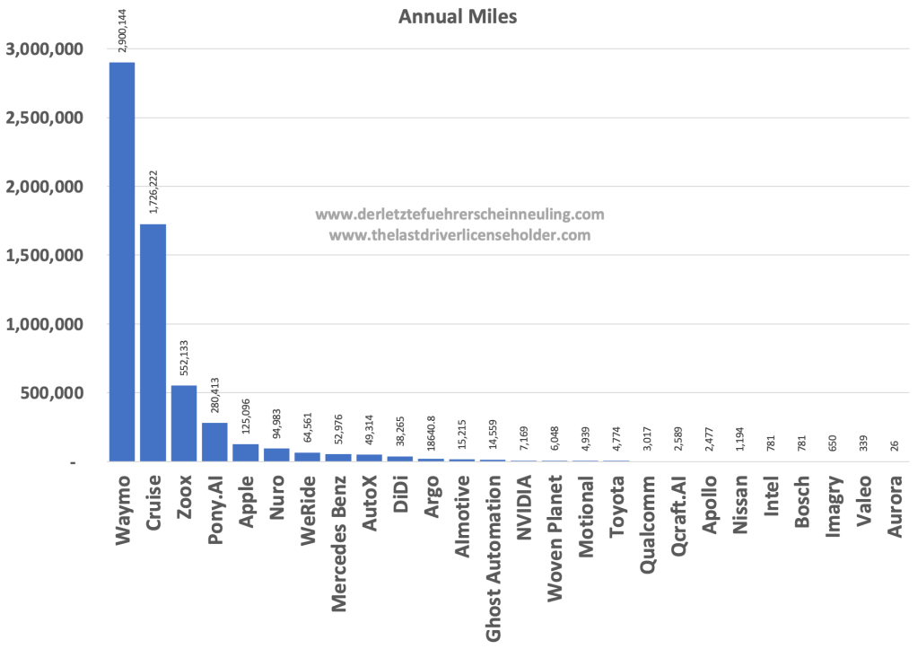
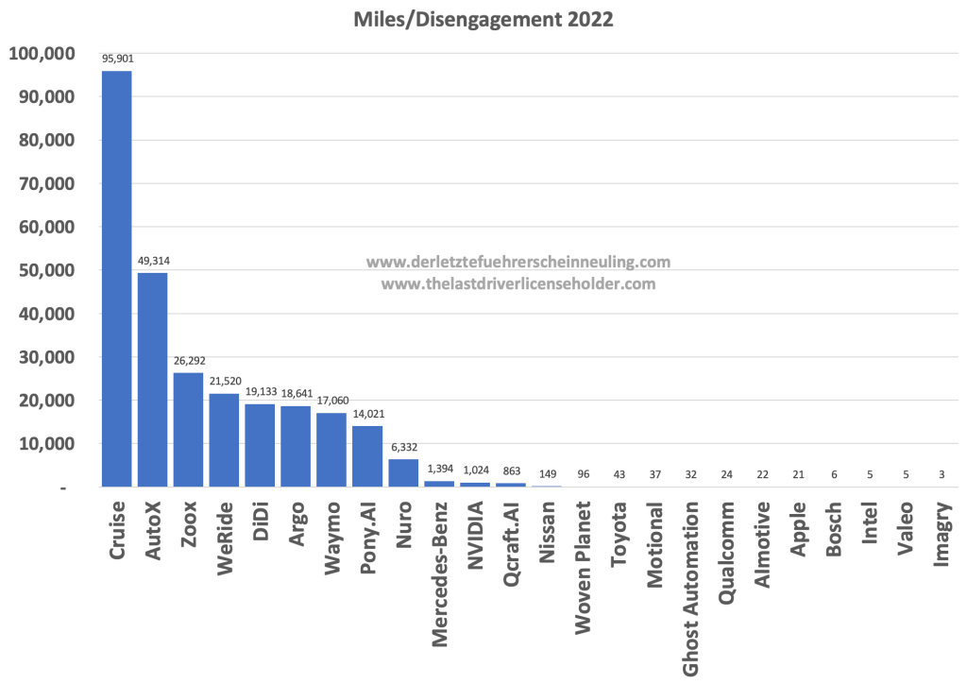
Reports with Safety Drivers (2022)
Number of miles driven per manufacturer
Number of miles driven per disengagement

Slide 31
Driverless Reports (2022)
Seven companies (Apollo, AutoX, Cruise, Nuro, Waymo, WeRide, and Zoox) have driverless licenses in California
Cruise completed the majority of driverless driving with 546,492 mi in San Francisco.
No disengagements are given by the manufacturers because, according to the definition, they require the intervention of a safety driver on board.
Cruise’s permit to operate driverless vehicles was revoked by California DMV in Oct. 2023, since it withheld video of a crash
https://edition.cnn.com/2023/10/24/business/california-dmv-cruise-permit-revoke/index.html
﻿ | Miles | Vehicles
Apollo (Baidu) | 21,774 | 4
Cruise | 546,492 | 222
Nuro | 924 | 9
Waymo | 51,639 | 317
WeRide | 2,859 | 3
﻿Total | 623,689 | 555

Slide 32
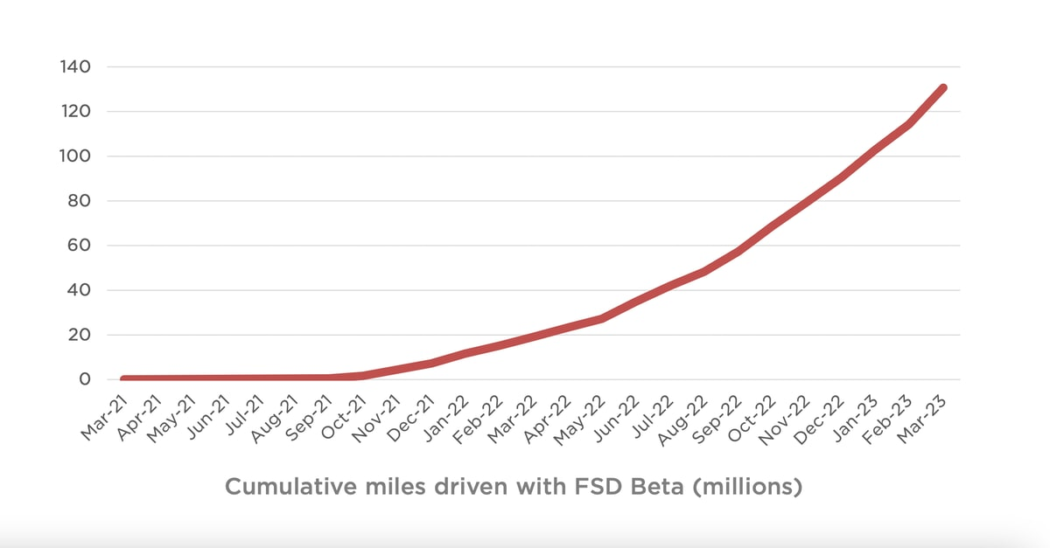
Where is Tesla?
Tesla does not appear in the 2022 report
“Tesla’s current interpretation of the FSD Beta, which is now in use in more than 300,000 customer vehicles, is that it is a driver assistance system that does not require reporting to the DMV.”
Tesla Surpasses 150 Million Miles Driven with FSD Beta (Apr. 2023)

Slide 33
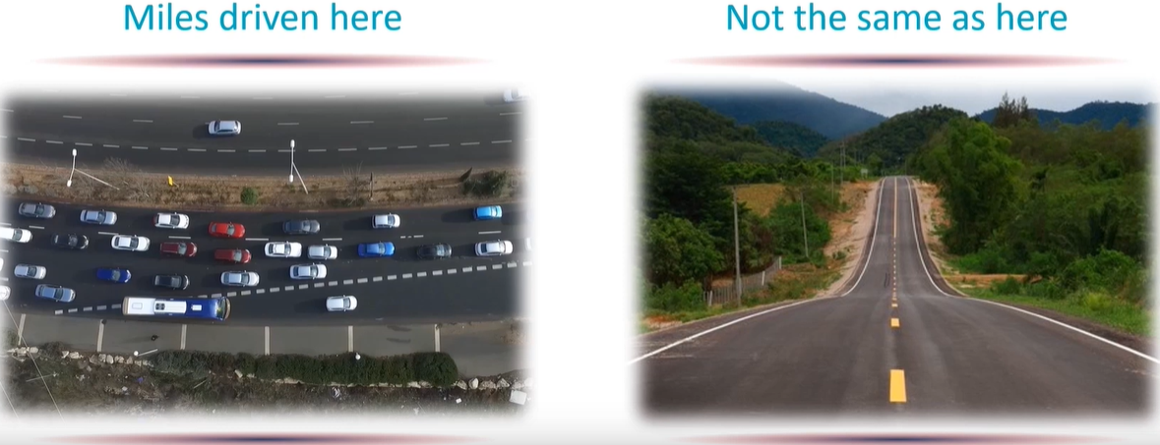
Is Miles Driven a Good Metric?
Not All Miles are Equal.
Driving conditions may be dramatically different.
Companies may be incentivized to avoid difficult driving conditions.

Slide 34
When will L5 AD Arrive?
Chris Urmson, CEO of Aurora:
“In 5 years” - 2009
“In 5 years” - 2012
“In 5 years” - 2015
“In 5 years” - 2018

Slide 35
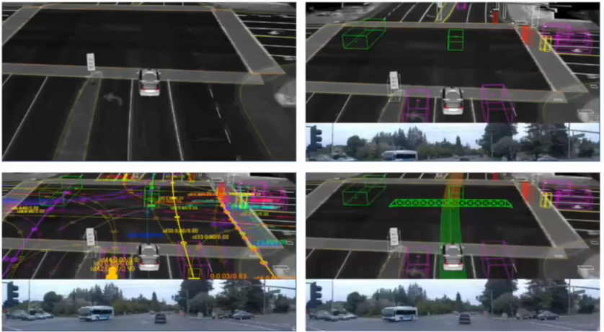
Four Major Tasks of an AV
Localization: Where am I?
Detection: What is around me?
Prediction: Where are they going?
Planning and Control: Where should I go?

Slide 36
AV Processing Pipeline
Perception:
Understanding the surrounding environment, incl. localization, object detection and tracking, etc.
Behavior prediction:
Predict objects’ future movements
Planning:
Plan a path/trajectory for the ego-vehicle in the context of other road users
Control:
Moving the vehicle to follow the planned trajectory
Sensor Data
(Camera, Lidar, Radar…)
Perception
Behavior Prediction
Planning
Control
Control cmds
(throttle, brake, steering)
Objects
(Cars, pedestrians,…)
Object
Futures
Ego-vehicle
Trajectory

Slide 37
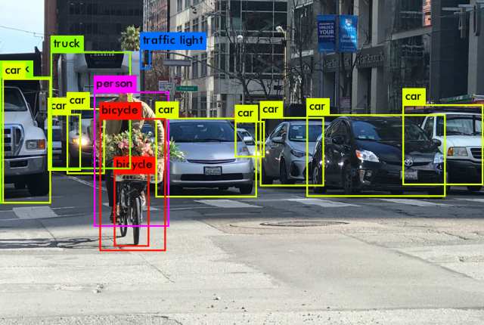
Perception
Localization
Static object detection
Dynamic object detection and tracking

Slide 38
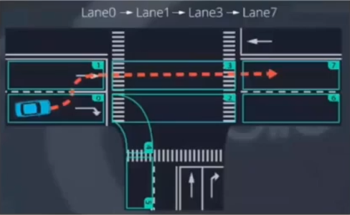
Behavior Prediction
Based on state
Kalman filter
Particle filter
Data-driven
ML-based classification
Pedestrian intention prediction
Based on visual cues such as pose, etc.

Slide 39
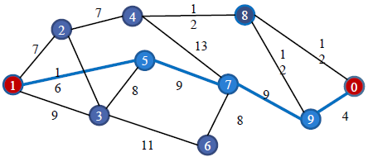
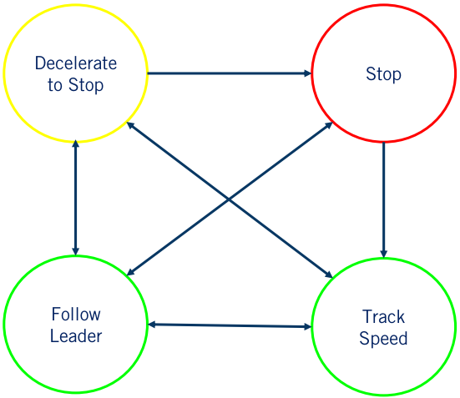
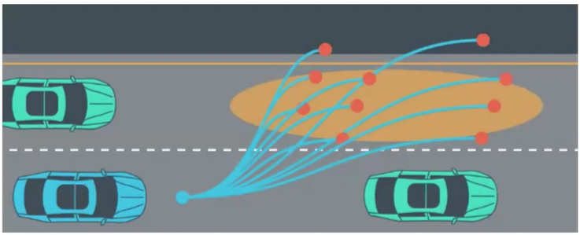
Planning
Mission Planning: use graph search to find a path from source to destination on the map
Behavior Planning: plan the set of high-level driving actions or maneuvers to safely achieve the driving mission under various driving conditions
Local Planning: plan a safe and smooth trajectory (vehicle pose as function of time)

Slide 40
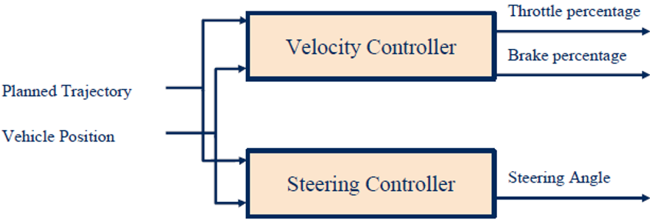
Control
Velocity controller for longitudinal speed control
Steering controller for lateral speed control
Notes:
Common control algorithms
PID: Proportional Integral Derivative
MPC: Model-Predictive Control

Slide 41
ML/DL Applied in the AV Pipeline
Classic AD processing pipeline: separate algorithms for each processing stage
ML, esp. Deep Neural Networks, may be deployed at different stages of the AD processing pipeline
(b): DNNs deployed in the Perception stage only, the prevalent approach in industry practice.
(c): end-to-end control, e.g., mapping from input images to control, trained with Imitation Learning or Reinforcement Learning.
(d): mid-to-mid approach, e.g., a separate perception module outputs Bird’s Eye View as input to downstream modules.
Notes:
Classic AD processing pipeline: separate algorithms for each processing stage.
Where does ML/DL come in?
CNN (Convolutional Neural Networks) for perception is well accepted.
DNN trained with Imitation Learning (IL) or Reinforcement Learning (RL) is still in the early-research stage.
“End-to-end” mapping from pixels to control commands
Many variants of hybrid approaches, e.g., “half-way” mapping from pixels to waypoints used for planning
Several companies are making a bet on it, incl. Waymo, Voyage, Wayve…
Where does ML/DL come in?
CNN (Convolutional Neural Networks) for perception is well accepted.
DNN trained with Imitation Learning (IL) or Reinforcement Learning (RL) is still in the early-research stage.
“End-to-end” mapping from pixels to control commands
Many variants of hybrid approaches, e.g., “half-way” mapping from pixels to waypoints used for planning
Several companies are making a bet on it, incl. Waymo, Voyage, Wayve…

